Slide 1

MASTER’S DEGREE IN COMPUTER ENGINEERING
QUANTUM COMPUTING AND QUANTUM INTERNET
PROJECT DISCUSSION
E91 PROTOCOL
PROFESSORS
STUDENT
LUCIANO LENZINI
LEONARDO BACCIOTTINI
GIOVANNI LIGATO
UNIVERSITY OF PISA

Slide 2

MASTER’S DEGREE IN COMPUTER ENGINEERING
QUANTUM COMPUTING AND QUANTUM INTERNET
PROJECT DISCUSSION
E91 PROTOCOL
PROFESSORS
STUDENT
LUCIANO LENZINI
LEONARDO BACCIOTTINI
GIOVANNI LIGATO
UNIVERSITY OF PISA

Slide 3

INTRODUCTION
Securely sharing cryptographic keys over insecure channels is a fundamental challenge in modern cryptography.
BACKGROUND
Classical key distribution methods rely on computational hardness, which can be broken by advances in computing.
THE PROBLEM
The E91 protocol leverages quantum mechanics (entanglement and the no-cloning theorem) to enable infinitely secure key distribution, immune to eavesdropping.
SOLUTION

Slide 4
SCENARIOS TO ANALYZE
1. IDEAL CONDITIONS
2. CHANNEL ERRORS
3. EAVESDROPPING

Slide 5

1. IDEAL
CONDITIONS
2. CHANNEL
ERRORS
SCENARIOS
TO ANALYZE
3. EAVESDROPPING

Slide 6


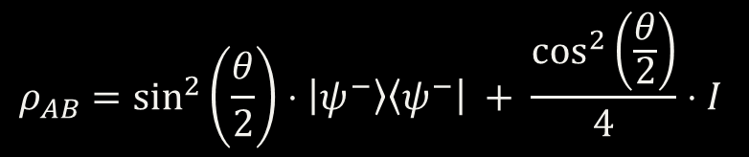








THE SPECIALIZED CIRCUIT FOR GENERATING WERNER STATES
CONTROLLED BY CHARLIE
$${|0⟩}_{A}$$
$$R_{y}(θ)$$
$H$
$${|0⟩}_{B}$$
+
$X$
$H$
$$0_{C}$$
$$C=1$$
$$C=0$$
$$C=1$$
$$C=0$$
$$ρ_{AB}=\sin^{2}\left(\frac{θ}{2}\right)⋅\left|ψ^{−}\right\rangle \left\langle ψ^{−}\right| + \frac{\cos^{2}\left(\frac{θ}{2}\right)}{4}⋅I$$

Slide 7
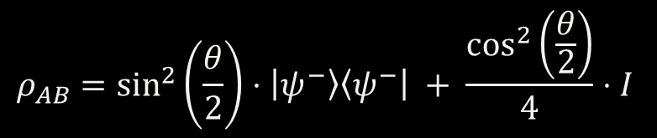


$$ρ_{AB}=\sin^{2}\left(\frac{θ}{2}\right)⋅\left|ψ^{−}\right\rangle \left\langle ψ^{−}\right| + \frac{\cos^{2}\left(\frac{θ}{2}\right)}{4}⋅I$$
THIS IS A WERNER STATE WHEN THE WERNER PARAMETER ($w$) IS SET TO
$$w=\sin^{2}\left(\frac{θ}{2}\right) → ρ_{AB} = w⋅\left|ψ^{−}\right\rangle \left\langle ψ^{−}\right| + \frac{1−w}{4}⋅I$$
THE FIDELITY CAN BE OBTAINED FROM THE WERNER PARAMETER USING THE FOLLOWING FORMULA:
$$F=\frac{3w+1 }{4}$$

Slide 8
1. IDEAL CONDITIONS

Slide 9
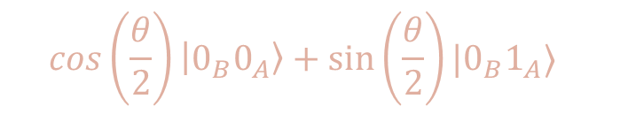
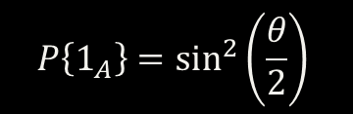
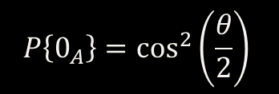
CIRCUIT ANALYSIS
$${|0⟩}_{A}$$
$$R_{y}(θ)$$
$H$
$${|0⟩}_{B}$$
+
$X$
$H$
$$0_{C}$$
$$C=1$$
$$C=0$$
$$C=1$$
$$C=0$$
$$\cos\left(\frac{θ}{2}\right)\left|0_{B}0_{A}\right\rangle +\sin\left(\frac{θ}{2}\right)|0_{B}1_{A}⟩$$
$$P\left\{0_{A}\right\}=\cos^{2}\left(\frac{θ}{2}\right)$$
MEASUREMENT PROBABILITIES FOR ALICE’S QUBIT
$$P\left\{1_{A}\right\}=\sin^{2}\left(\frac{θ}{2}\right)$$

Slide 10



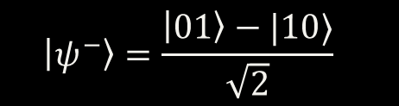



IN THE IDEAL CASE, SETTING $θ=π$ SIMPLIFIES THE CIRCUIT AS FOLLOWS
(AFTER MEASURING ALICE'S QUBIT)
$$P\left\{1_{A}\right\}=\sin^{2}\left(\frac{π}{2}\right)=1$$
$$P\left\{0_{A}\right\}=\cos^{2}\left(\frac{π}{2}\right)=0$$
$${|1⟩}_{A}$$
$H$
$$\left|ψ^{−}\right\rangle =\frac{\left|01\right\rangle −|10⟩}{\sqrt{2}}$$
$${|0⟩}_{B}$$
+
$X$
BELL GATE

Slide 11
2. CHANNEL ERRORS

Slide 12

IN THE PRESENCE OF CHANNEL ERRORS, THEY ARE SIMULATED USING THE GENERAL CIRCUIT PREVIOUSLY ILLUSTRATED, WITH THE FOLLOWING $θ$ VALUES:
$$0≤θ<π$$
NOTE THAT WHEN $θ=0$, THE OUTPUT OF THE CIRCUIT WILL BE A COMPLETELY DEPOLARIZED STATE.

Slide 13
CHANNEL ERRORS
EXPLAIN HOW THEY ARE INTRODUCED VIA THE SPECIALIZED CIRCUIT
ADD THE SCREEN OF THE CIRCUIT AND FORMULAS…
$$w⋅\left|ψ^{−}\right\rangle \left\langle ψ^{−}\right| + \frac{1−w}{4}⋅I$$

Slide 14
3. EAVESDROPPING

Slide 15








IN THE EAVESDROPPING SCENARIO EVE TAKES CONTROL OF THE SITE-GENERATING ENTANGLED PHOTON PAIRS
$${|0⟩}_{A}$$
$X$
$$\frac{1}{2}$$
$$|0_{B}1_{A}⟩$$
$${|0⟩}_{B}$$
EVE SENDS ONE OF THE FOLLOWING TWO STATES TO ALICE AND BOB WITH EQUAL PROBABILITY (1/2), INSTEAD OF AN ENTANGLED PAIR OF PHOTONS.
$${|0⟩}_{A}$$
$$|1_{B}0_{A}⟩$$
$$\frac{1}{2}$$
$${|0⟩}_{B}$$
$X$

Slide 16
BEFORE ANALYZING THE RESULTS,
IT IS IMPORTANT TO HIGHLIGHT SOME KEY DETAILS.

Slide 17
KEY
DETAILS

Slide 18


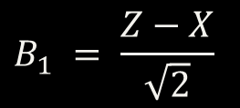
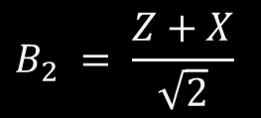
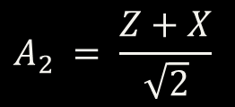

CHALLENGES
PROTOCOL DETAILS
ALICE
BOB
$$A_{0} = Z$$
$$B_{0} = Z$$
$$B_{1} = \frac{Z−X}{\sqrt{2}}$$
$$A_{1} = X$$
OBSERVABLES
$$A_{2} = \frac{Z+X}{\sqrt{2}}$$
$$B_{2} = \frac{Z+X}{\sqrt{2}}$$
CHSH CORRELATION VALUE
$$S= | \left\langle A_{0}B_{2} \right\rangle +\left\langle A_{0}B_{1} \right\rangle +\left\langle A_{1}B_{2} \right\rangle − ⟨ A_{1}B_{1} ⟩ |$$
The 0-indexed notation is used, as in the Python code, to avoid confusion between slides and implementation.

Slide 19







NOTEWORTHY IMPLEMENTATION STEPS
THEORY
1. DEFINE THE OBSERVABLE$O$
2. FIND ITS EIGENVALUES AND EIGENVECTORS
OBSERVABLE
${λ_{i} → \left|λ\right\rangle }_{i} =\left[\begin{matrix}λ_{i}^{(1)} \\ λ_{i}^{(2)}\end{matrix}\right] i=1,2$
3. DETERMINE THE UNITARY TRANSFORMATION MAPPING
EIGENVECTORS TO STANDARD BASIS STATES
HERMITIAN MATRIX
$$\left[\begin{matrix}λ_{1}^{(1)} & λ_{1}^{(2)} & 0 & 0 \\ 0 & 0 & λ_{1}^{(1)} & λ_{1}^{(2)} \\ λ_{2}^{(1)} & λ_{2}^{(2)} & 0 & 0 \\ 0 & 0 & λ_{2}^{(1)} & λ_{2}^{(2)}\end{matrix}\right]⋅\left[\begin{matrix}a \\ b \\ c \\ d\end{matrix}\right]=\left[\begin{matrix}1 \\ 0 \\ 0 \\ 1\end{matrix}\right]$$
$$|0⟩$$
REAL EIGENVALUES
$$|1⟩$$
4. VERIFY THE FOUND MATRIX IS UNITARY
CAN BE DISPLAYED ON THE MEASURING DEVICE
$$U=\left[\begin{matrix}a & b \\ c & d\end{matrix}\right] → UU^{†}=U^{†}U=I$$
5. APPLY THE UNITARY TRANSFORMATION TO THE QUBIT AND
MEASURE IN THE STANDARD BASIS
MEASUREMENT CAUSES COLLAPSE INTO ONE OF THE EIGENSPACES ASSOCIATED WITH THE RELATIVE EIGENVALUE.
$$|ψ⟩$$
$U$
THIS ENTIRE PROCESS ENABLES
MEASUREMENT AS IF USING THE ORIGINAL OBSERVABLE$O$

Slide 20
METRICS AND PARAMETERS

Slide 21

METRICS TO EVALUATE
CHSH
CORRELATION VALUE
$$S= | \left\langle A_{0}B_{2} \right\rangle +\left\langle A_{0}B_{1} \right\rangle +\left\langle A_{1}B_{2} \right\rangle − ⟨ A_{1}B_{1} ⟩ |$$
NUMBER OF MISMATCHED BITS BETWEEN ALICE’S AMD BOB’S SECRET KEYS
$$R_{mis}=\frac{m}{l }$$
MISMATCH RATIO
TOTAL KEY LENGTH
PLOTTED AS A FUNCTION OF $θ$ OR OF THE WERNER PARAMETER

Slide 22


n
NUMBER OF EXECUTIONS PER SETTING
$$θ$$
THETA VALUES USED FOR GENERATING THE WERNER STATES
EXPERIMENT PARAMETERS
Eavesdropping
WHETHER EVE IS EAVESDROPPING OR NOT
#EPR Pairs
NUMBER OF EPR PAIRS GENERATED IN ONE PROTOCOL EXECUTION

Slide 23
RESULTS
ANALYSIS

Slide 24
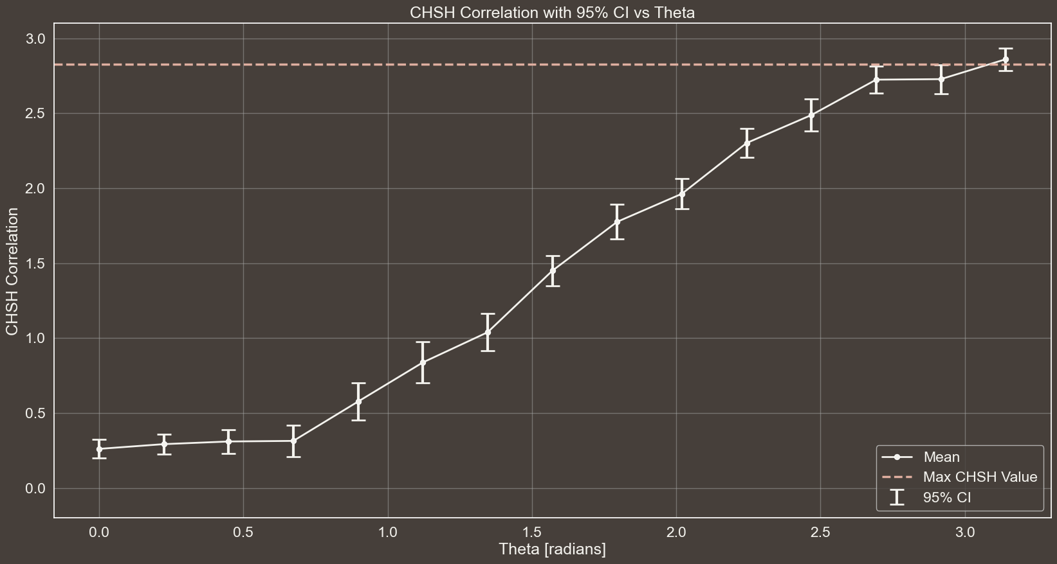




CHSH CORRELATION WITH 95% CI vs THETA
n$→$30
$θ→\left[\frac{i}{14}π | i=0,1, …, 14\right]$
Eavesdropping $→$False
#EPR Pairs $→$ 300

Slide 25
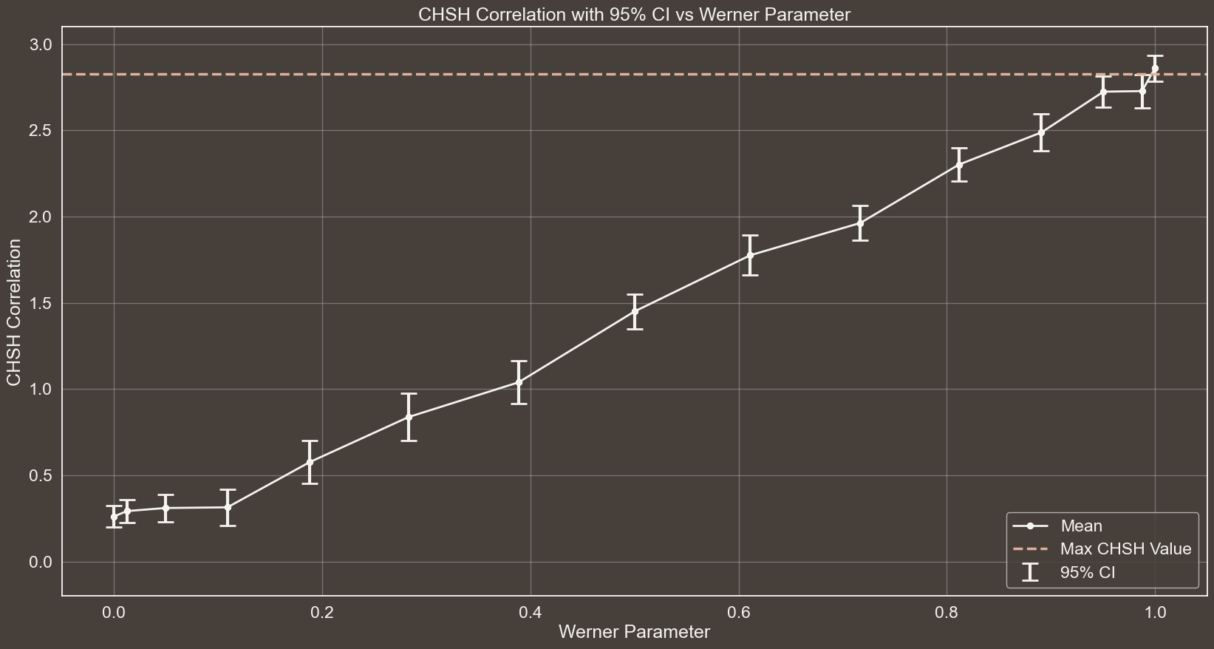
CHSH CORRELATION WITH 95% CI vs WERNER PARAMETER
n$→$30
$θ→\left[\frac{i}{14}π | i=0,1, …, 14\right]$
Eavesdropping $→$False
#EPR Pairs $→$ 300

Slide 26
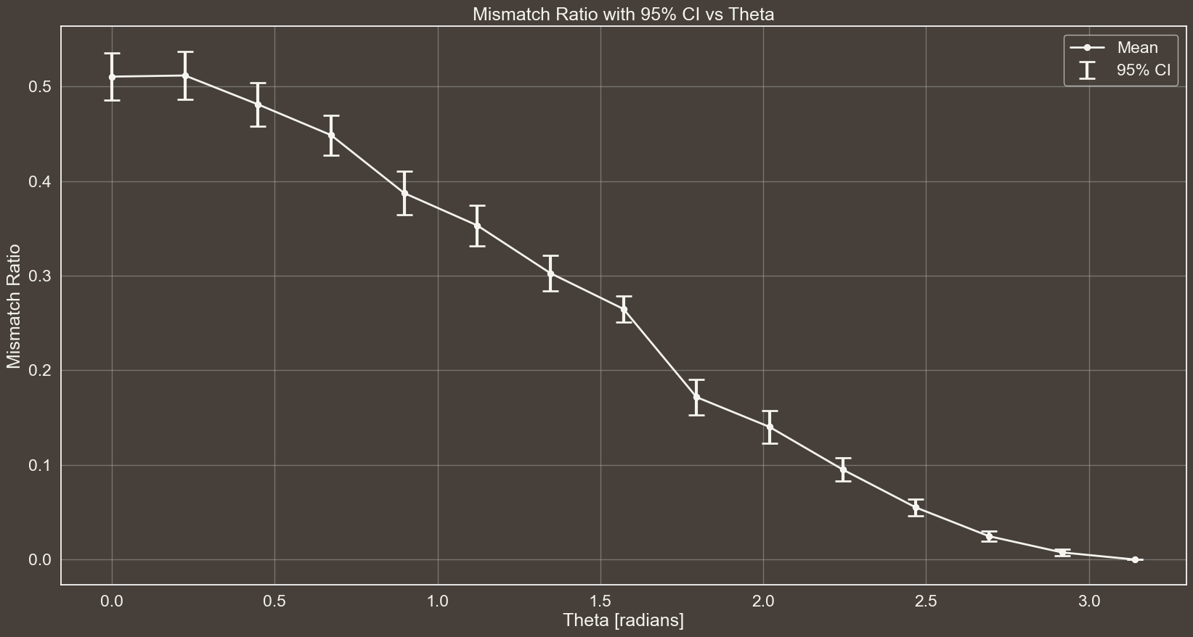
MISMATCH RATIO WITH 95% CI vs THETA
n$→$30
$θ→\left[\frac{i}{14}π | i=0,1, …, 14\right]$
Eavesdropping $→$False
#EPR Pairs $→$ 300

Slide 27
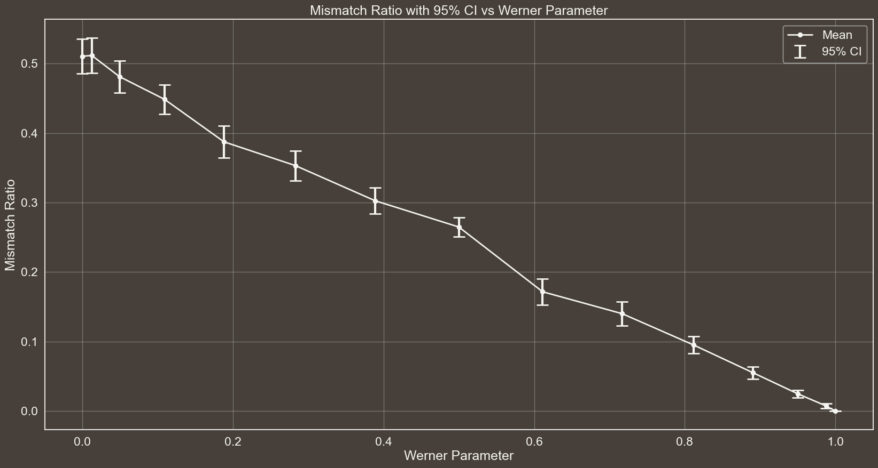
MISMATCH RATIO WITH 95% CI vs WERNER PARAMETER
n$→$30
$θ→\left[\frac{i}{14}π | i=0,1, …, 14\right]$
Eavesdropping $→$False
#EPR Pairs $→$ 300

Slide 28
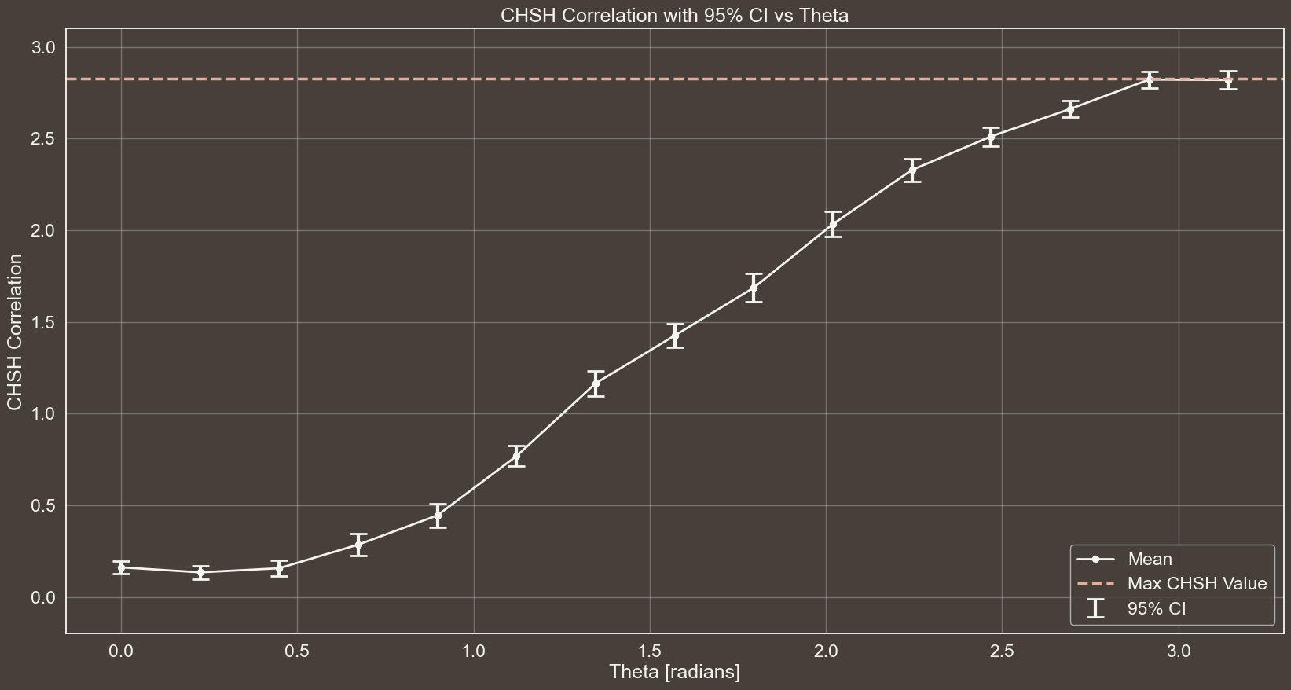


CHSH CORRELATION WITH 95% CI vs THETA
n$→$30
$θ→\left[\frac{i}{14}π | i=0,1, …, 14\right]$
Eavesdropping $→$False
#EPR Pairs $→$ 1000

Slide 29
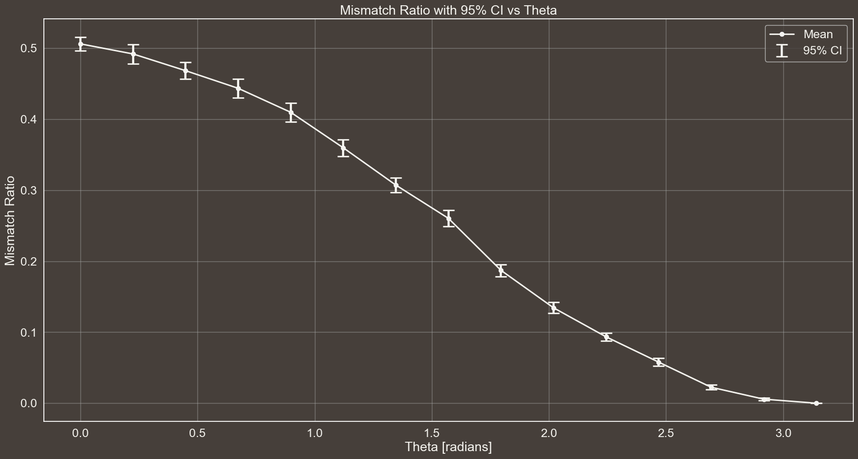
MISMATCH RATIO WITH 95% CI vs THETA
n$→$30
$θ→\left[\frac{i}{14}π | i=0,1, …, 14\right]$
Eavesdropping $→$False
#EPR Pairs $→$ 1000

Slide 30
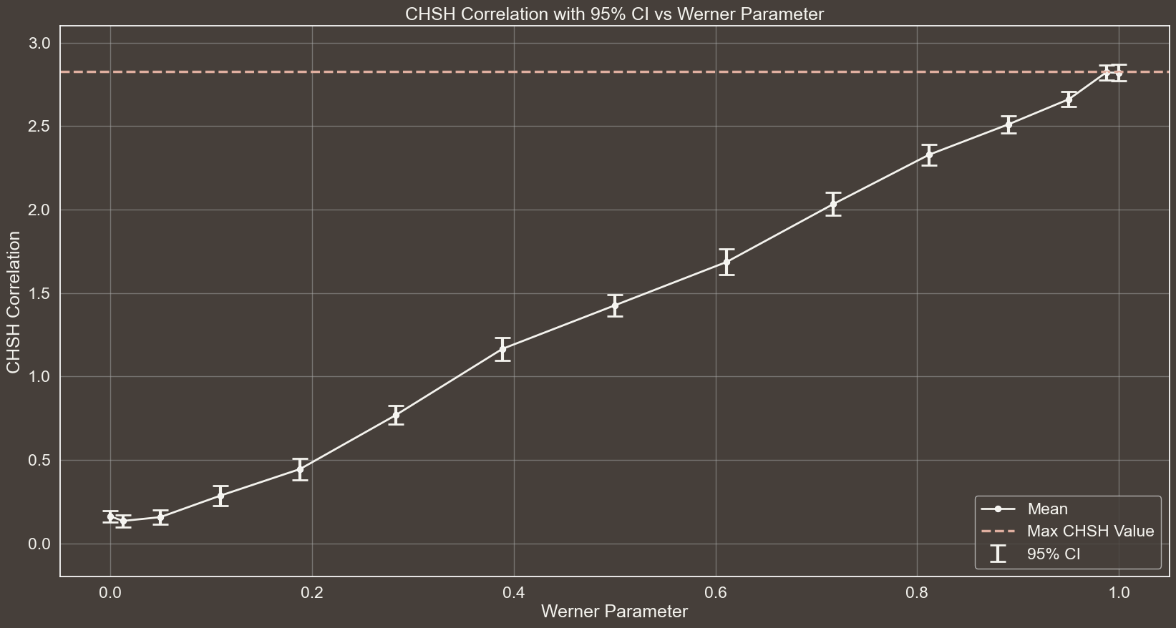
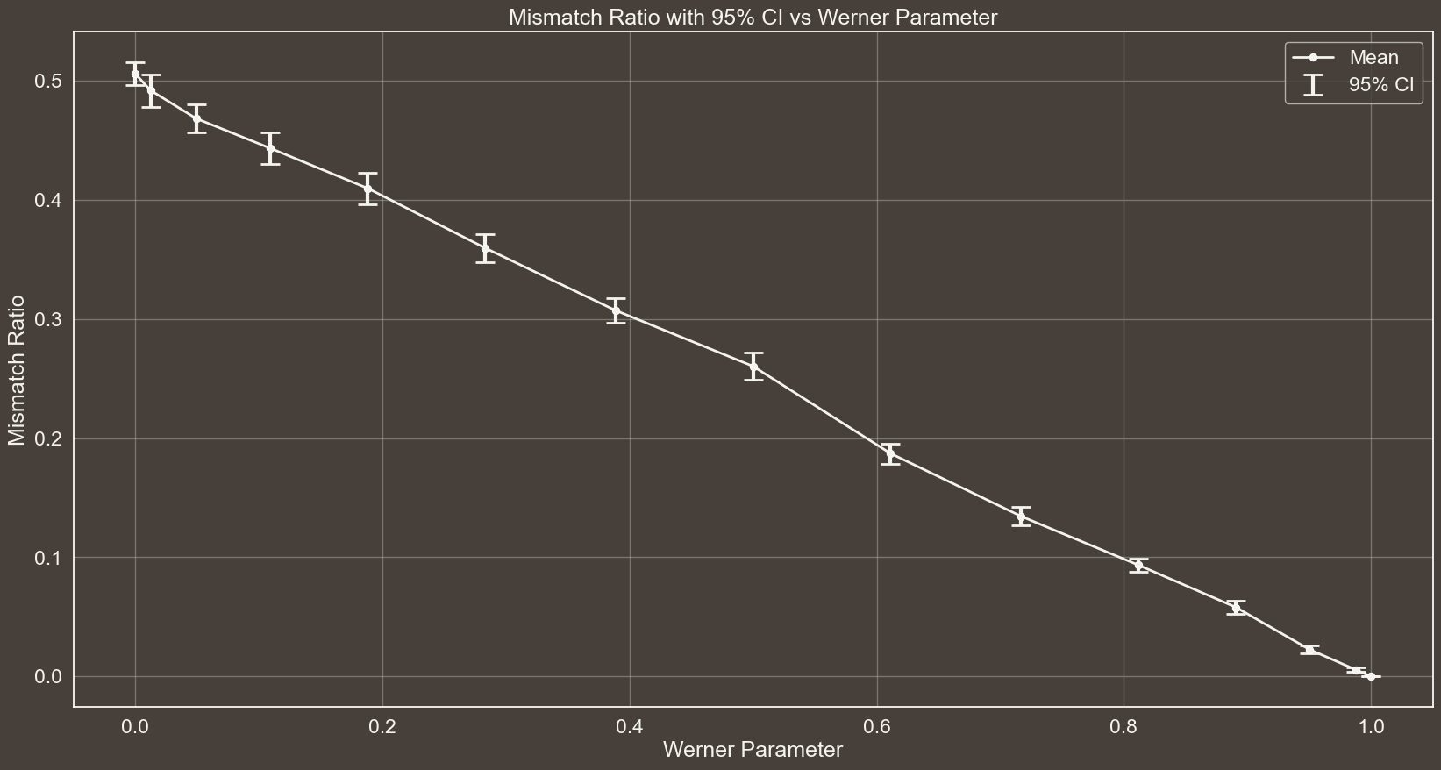

Slide 31




EXPLORING THE EFFECT OF #EPR PAIRS VARIATION
n$→$30
$θ→\left[\frac{i}{14}π | i=0,1, …, 14\right]$
Eavesdropping $→$False
#EPR Pairs $→$ 1000

Slide 32
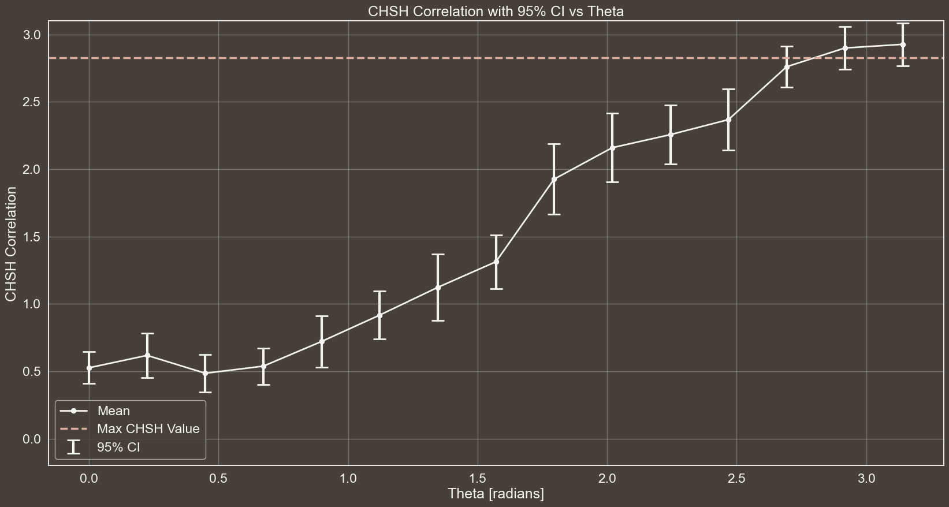


CHSH CORRELATION WITH 95% CI vs THETA
n$→$30
$θ→\left[\frac{i}{14}π | i=0,1, …, 14\right]$
Eavesdropping $→$False
#EPR Pairs $→$ 80

Slide 33
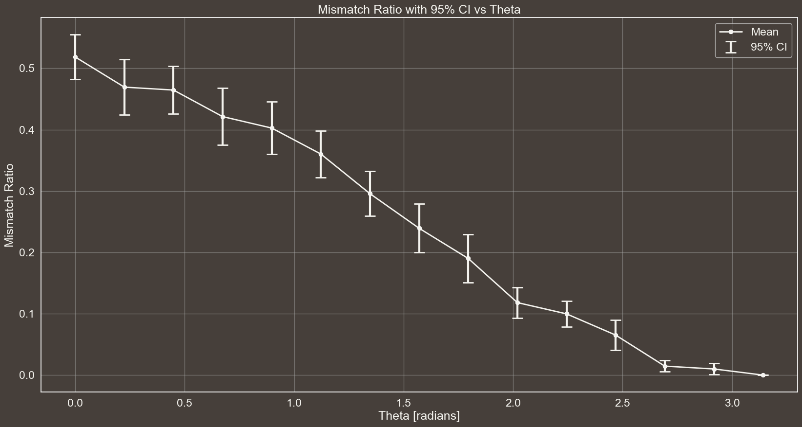
MISMATCH RATIO WITH 95% CI vs THETA
n$→$30
$θ→\left[\frac{i}{14}π | i=0,1, …, 14\right]$
Eavesdropping $→$False
#EPR Pairs $→$ 80

Slide 34
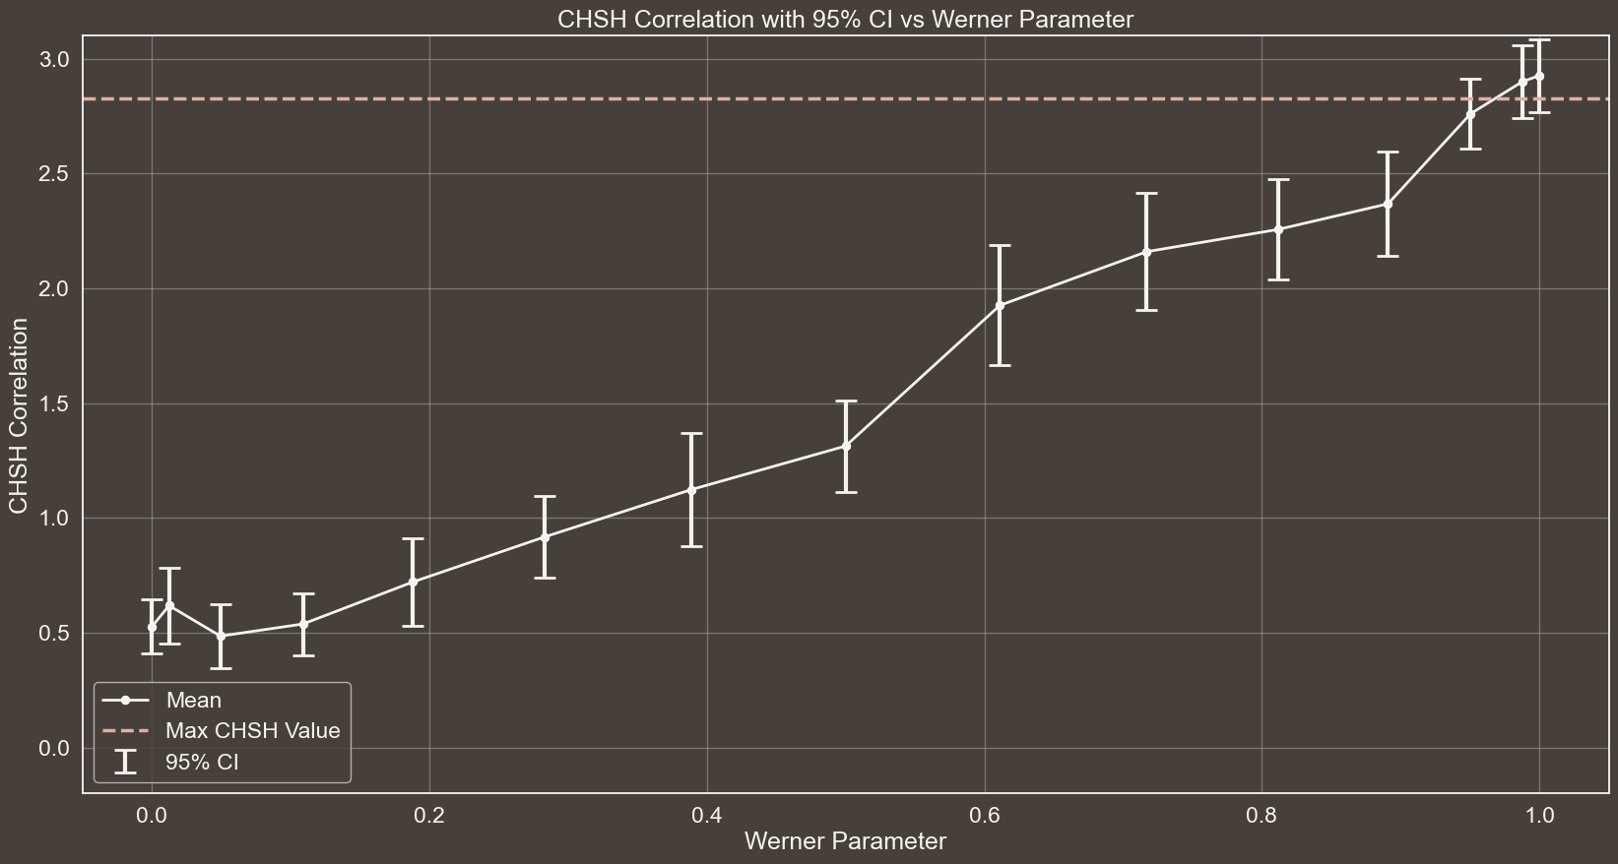
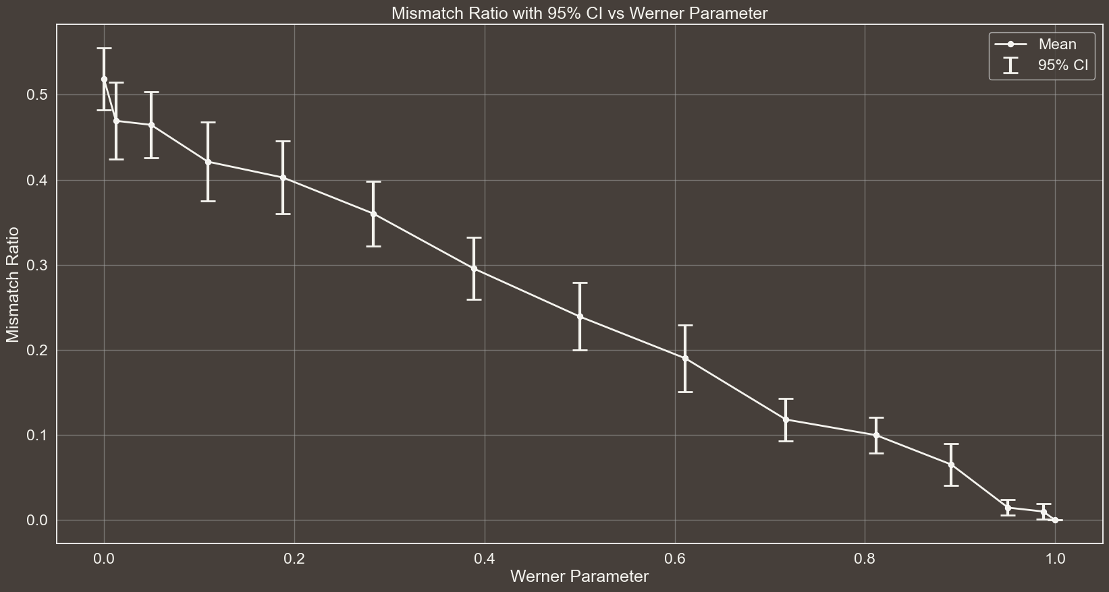

Slide 35

n$→$30
$θ→\left[\frac{i}{14}π | i=0,1, …, 14\right]$
Eavesdropping $→$False
#EPR Pairs $→$ 80

Slide 36
FARE CONFRONTO NUMERO DIVERSO EPR PAIRS

Slide 37
WHAT WILL BE THE RESULTS IN THE SCENARIO WHERE THERE IS EVE, THE EAVESDROPPER?
IN THIS SCENARIO, EVE SENDS ALICE AND BOB ONLY QUBIT PAIRS IN THE STATES $|01⟩$ AND $|10⟩$
SINCE THESE STATES ARE NOT ENTANGLED, THE CHSH CORRELATION SHOULD REFLECT THIS. INSTEAD OF REACHING THE THEORETICAL MAXIMUM OF $2\sqrt{2}$, THE VALUE WILL BE SIGNIFICANTLY LOWER. THIS ALLOWS ALICE AND BOB TO DETECT THE ANOMALY AND ABORT THE PROTOCOL.
REGARDING THE MISMATCH RATIO, WHEN BOTH ALICE AND BOB MEASURE USING THE $Z$ OBSERVABLE, THEY WILL OBTAIN ANTI-CORRELATED RESULTS (0 OR 1), PRODUCING A CORRECT MATCHING BIT FOR KEY GENERATION. HOWEVER, WHEN THEY BOTH MEASURE USING $\frac{Z+X}{\sqrt{2}}$, THE OUTCOME IS LESS STRAIGHTFORWARD, REQUIRING FURTHER CALCULATIONS.
TO MEASURE IN THIS OBSERVABLE, WE NEED A UNITARY TRANSFORMATION THAT MAPS ITS EIGENVECTORS TO THE STANDARD BASIS, FOLLOWED BY A MEASUREMENT IN THE $Z$ BASIS. THE REQUIRED UNITARY $U$ IS GIVEN BELOW AND MUST BE APPLIED TO BOTH QUBITS BEFORE MEASUREMENT.
$$U=\left[\begin{matrix}0.924 & 0.383 \\ −0.383 & 0.924\end{matrix}\right]$$
Results are rounded to three decimal places in the slides for presentation purposes. In Python, more decimals are considered for higher accuracy.

Slide 38
$$U=\left[\begin{matrix}0.924 & 0.383 \\ −0.383 & 0.924\end{matrix}\right]$$
CONSIDER THE CASE WHERE EVE SENDS $|10⟩$ TO ALICE AND BOB (THE ANALYSIS FOR THE OTHER STATE IS ANALOGOUS). THE STATE OF THE QUBITS AFTER APPLYING $U$TO BOTH CAN BE COMPUTED.
$$\left|10\right\rangle ⋅\left(U⨂U\right)=\left(0.383 | 0\right\rangle +0.924|1⟩) ⨂ (0.924\left|0\right\rangle −0.383|1⟩)=$$
$= 0.354|00⟩−0.147|01⟩+0.854|10⟩−0.354|11⟩$
ALL FOUR MEASUREMENT OUTCOMES IN THE $Z$ BASIS ARE POSSIBLE. WHEN THE OUTCOMES ARE 00 OR 11, THE RESULTS ARE CORRELATED, CAUSING BOB, UPON FLIPPING HIS VALUE, TO INTRODUCE A MISMATCH BETWEEN HIS KEY AND ALICE’S. THE PROBABILITY OF OBTAINING CORRELATED RESULTS IS GIVEN BY:
$0.354^{2}+0.354^{2}=0.251$
SINCE THIS SCENARIO REPRESENTS ONLY ONE OF THE TWO CASES CONTRIBUTING TO KEY GENERATION (THE OTHER BEING WHEN BOTH ALICE AND BOB CHOOSE $Z$ AS THE OBSERVABLE, WHICH DOES NOT INTRODUCE MISMATCHED BITS), MULTIPLYING BY $\frac{1}{2}$ GIVES THE TOTAL PROBABILITY OF KEY ERRORS.
$0.251⋅\frac{1}{2} =0.125$
IN THE MISMATCH RATIO PLOT, THE CONFIDENCE INTERVAL SHOULD ENCOMPASS THIS VALUE.
Results are rounded to three decimal places in the slides for presentation purposes. In Python, more decimals are considered for higher accuracy.

Slide 39
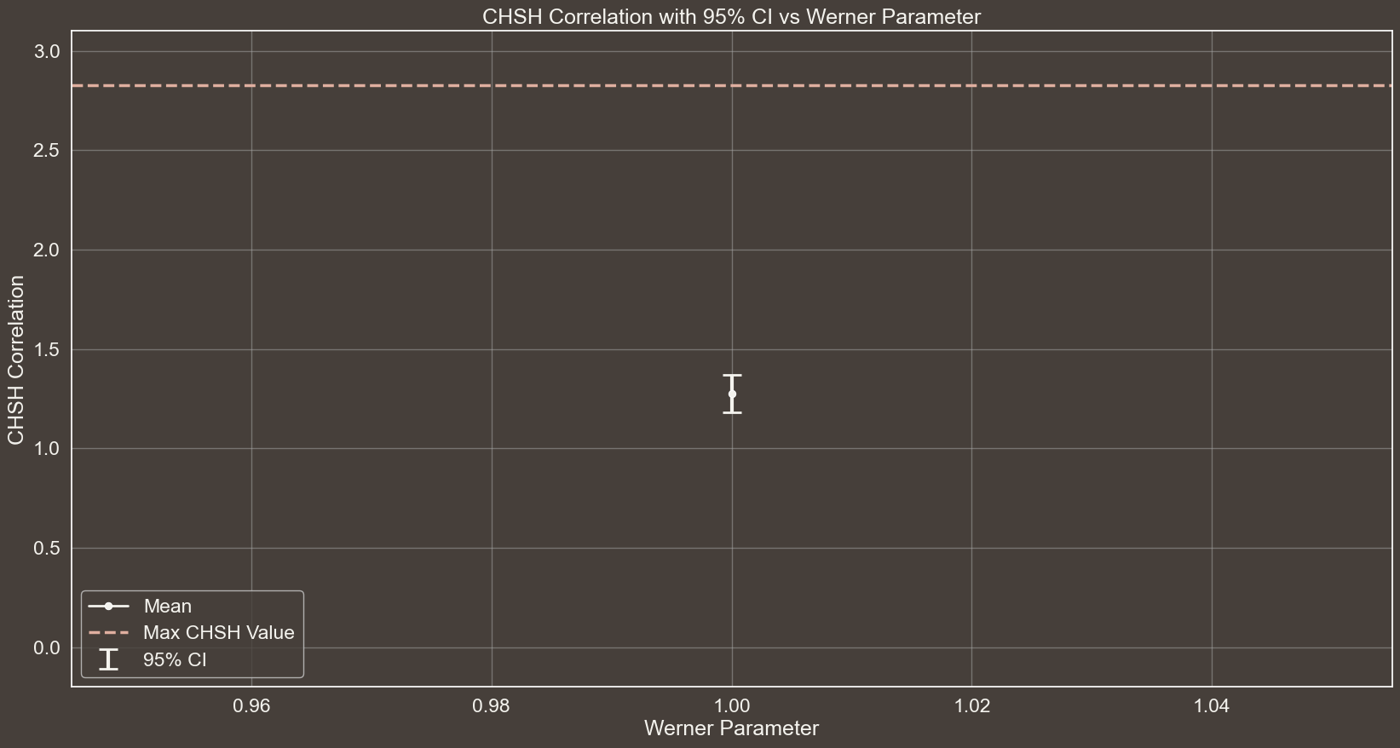




CHSH CORRELATION WITH 95% CI vs WERNER PARAMETER
n$→$30
$θ→\left[π\right]$
Eavesdropping $→$True
#EPR Pairs $→$ 300

Slide 40
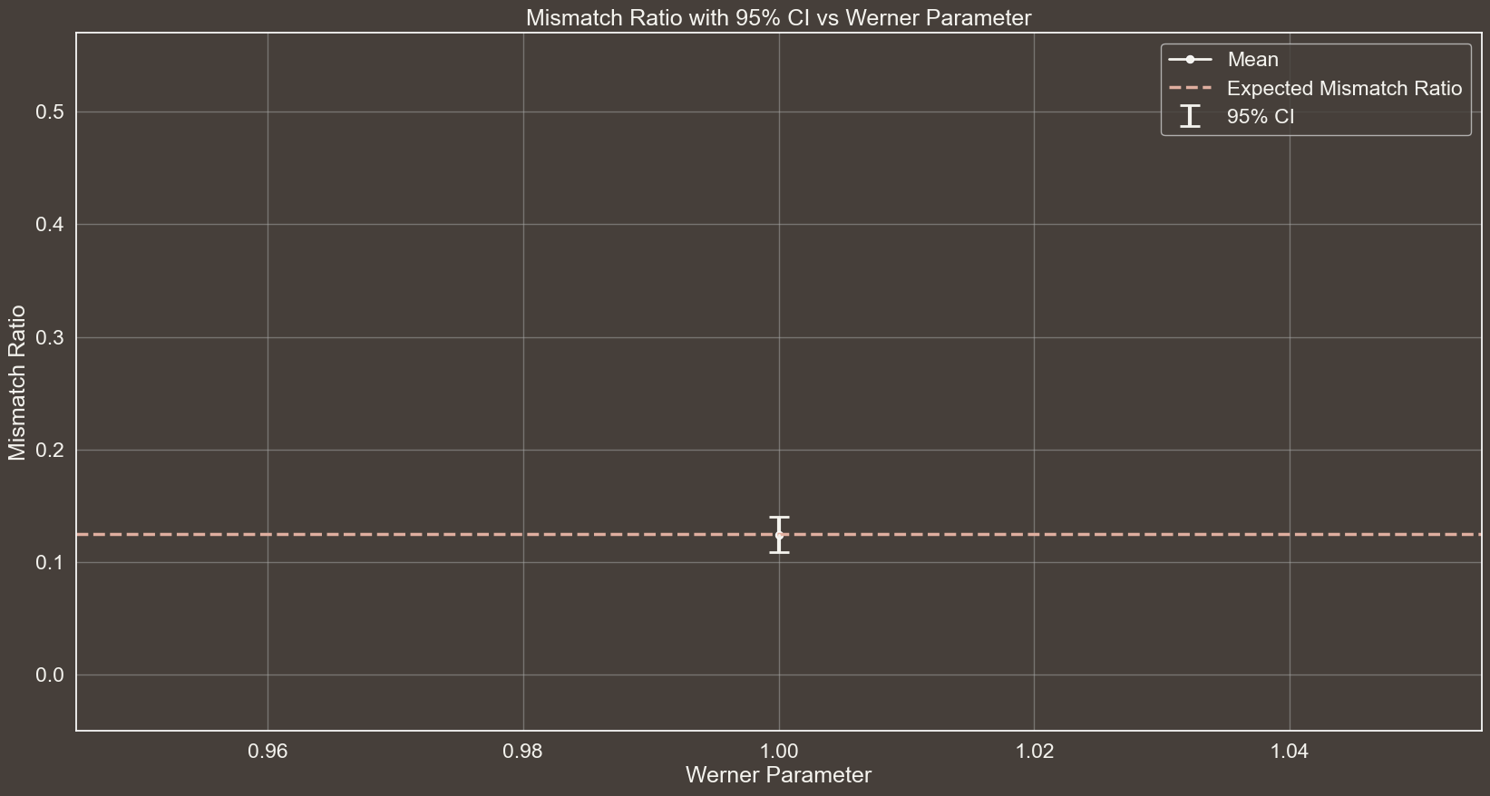
MISMATCH RATIO WITH 95% CI vs WERNER PARAMETER
n$→$30
$θ→\left[π\right]$
Eavesdropping $→$True
#EPR Pairs $→$ 300

Slide 41
REFERENCES
[1]
CHSH INEQUALITY
https://en.wikipedia.org/wiki/CHSH_inequality
[2]
QUANTUM CORRELATION
https://en.wikipedia.org/wiki/Quantum_correlation
[3]
TSIRELSON'S BOUND
https://en.wikipedia.org/wiki/Tsirelson's_bound
Notes:
Didi Chuxing implementa il monitoraggio telemetrico della guida (algoritmo di machine learning per verificare frenate brusche, accelerazioni brusche e altri parametri che definiscono una guida pericolosa.

Slide 42


REFERENCES
[1]
CHSH INEQUALITY
https://en.wikipedia.org/wiki/CHSH_inequality
https://coolors.co/palette/463f3a-8a817c-bcb8b1-f4f3ee-e0afa0
[2]
QUANTUM CORRELATION
https://en.wikipedia.org/wiki/Quantum_correlation
[3]
TSIRELSON'S BOUND
https://en.wikipedia.org/wiki/Tsirelson's_bound
www.flaticon.com
Notes:
Didi Chuxing implementa il monitoraggio telemetrico della guida (algoritmo di machine learning per verificare frenate brusche, accelerazioni brusche e altri parametri che definiscono una guida pericolosa.

Slide 43
THANKS
FOR YOUR ATTENTION

